Slide 1
Orienteering Problem with Moving Targets
Waste Collection in the Ocean
Master Thesis – Paulina Heine

Slide 2
Motivation
Global Accumulation
Ocean plastic collects in major convergence zones across the globe.
Once plastic enters a zone, it is unlikely to ever leave again.
The Great Pacific Garbage Patch (GPGP)
The GPGP is the largest of these accumulation zones.
The thesis focus is on this area because there is the most information/literature about the GPGP.
It's not a solid island, but a vast area with a high concentration of plastic.
Modelling Assumption
Within the GPGP, there are regional areas with even higher plastic density. We simplify these areas by modelling them as small and dense "hotspots" in order to build a model for an orienteering problem.*
*Important: This is the biggest simplification/ assumption in the model, we sum up the debris in an area to a hotspot, while in reality is is more like a “cloud” .

Slide 3
Motivation
Key Challenges
Area: The collection area is estimated to cover 1.6 million square kilometers.
Dynamic Environment: Debris and hotspots are constantly moving with the currents, making them difficult to track.
Which debris is collectable?
Large, Floating Debris: Most of the plastic mass in the GPGP is from debris larger than 5 cm. Additionally, 60% of this plastic is less dense than water, causing it to float near or on the surface.
it is important to collect the large debris, before it is overgrown with algae, causing it to sink or before it decomposes to smaller debris, making it harder to collect it
Accessible by Boat: This concentration of large, floating debris makes it fundamentally possible to collect using boat-based systems.

Slide 4
Problem Components
Hotspots:
Each hotspot represents a mix of different debris types.
Hotspots are defined by their area, density, and weight.
These properties determine both the "value" of collecting a hotspot and its mobility in the water.
Collection Boats:
They have a predefined speed which is influenced by the current.
To reach a target, they travel the Euclidean distance to it.
Environmental Dynamics:
Ocean currents are a key factor, influencing two major aspects of the problem:
The constant drift and changing location of the hotspots.
The navigation and travel time of the collection boats.

Slide 5
Problem modelled as an Orienteering Problem
Value Assignment: Each plastic hotspot is assigned a score based on size, density and area.
Selective Collection: We have a fixed time limit – visiting all hotspots is not possible.
Route Optimization: The model is supposed to find a good/ the optimal sequence of hotspots for one or more vessels. Vessels start from a defined location and don’t need to return.
Objective: Maximize the total collected score. → By strategically selecting which hotspots to visit. → And in what order, within the given time constraints.

Slide 6
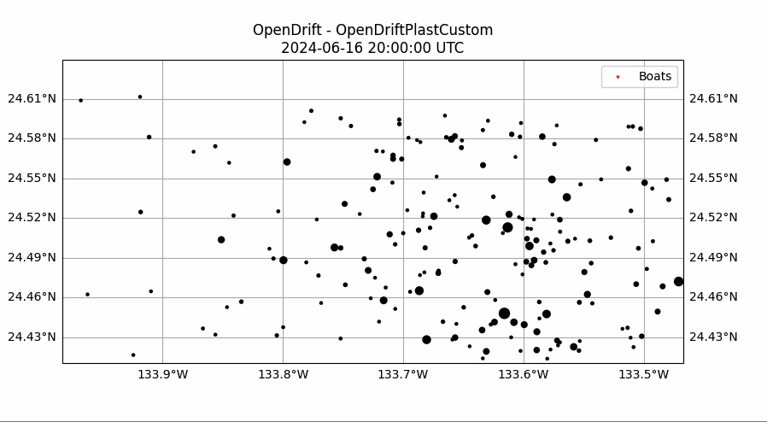
Data and Modelling
Ocean Currents: real-world ocean current data from the Copernicus Data Space Ecosystem, a program of the European Union. The specific dataset is for June 2024. → https://data.marine.copernicus.eu
Plastic Hotspots: The hotspot data for this project is synthetically generated. It does not rely on actual satellite tracking of debris.
Python-based Opendrift package → Enables dynamic simulation of particles under realistic current conditions
Black dots in the video represent plastic hotspots

Slide 7
Solution Approach
To find an effective collection strategy, two methods are compared: a pre-planned optimal route and a real-time adaptive heuristic.
Approach 1: Static-First Optimization
Simplify & Solve: Reduce the problem's complexity by ignoring ocean currents, treating it as a static Orienteering Problem. This version is then solved with an optimization solver to find a theoretically optimal route.
Simulate & Evaluate: This pre-planned "optimal" static route is then applied in the dynamic simulation to test how well it performs under realistic, moving conditions.
Approach 2: Reactive Greedy Heuristic
Real-time Decisions: This approach doesn't follow a pre-planned path. Instead, boats are assigned to the next best hotspot in real-time.
Selection Criteria: The decision is based on a combination of the hotspot's value and its current distance from the boat.

Slide 8
Solution Approach
Inputs
Hotspot data: The initial location and composition of each hotspot.
Ocean Ddta: Real-world ocean current data
Static exact optimization
Test both methods in the dynamic environment
Reactive greedy heuristic

Slide 9
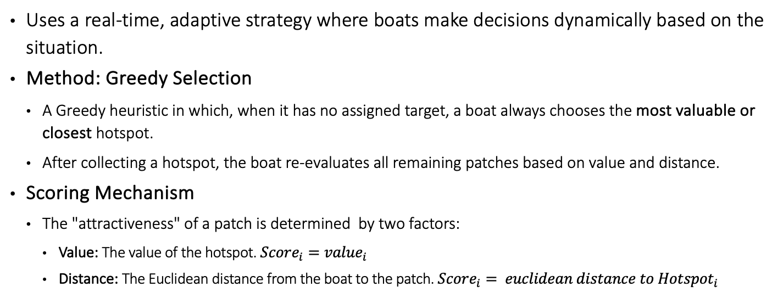
Reactive Greedy Heuristic Approach
Uses a real-time, adaptive strategy where boats make decisions dynamically based on the situation.
Method: Greedy Selection
A Greedy heuristic in which, when it has no assigned target, a boat always chooses the most valuable or closest hotspot.
After collecting a hotspot, the boat re-evaluates all remaining patches based on value and distance.
Scoring Mechanism
The "attractiveness" of a patch is determined by two factors:
Value: The value of the hotspot. $Score_{i}=value_{i}$
Distance: The Euclidean distance from the boat to the patch. $Score_{i}= euclidean distance to {Hotspot}_{i}$

Slide 10
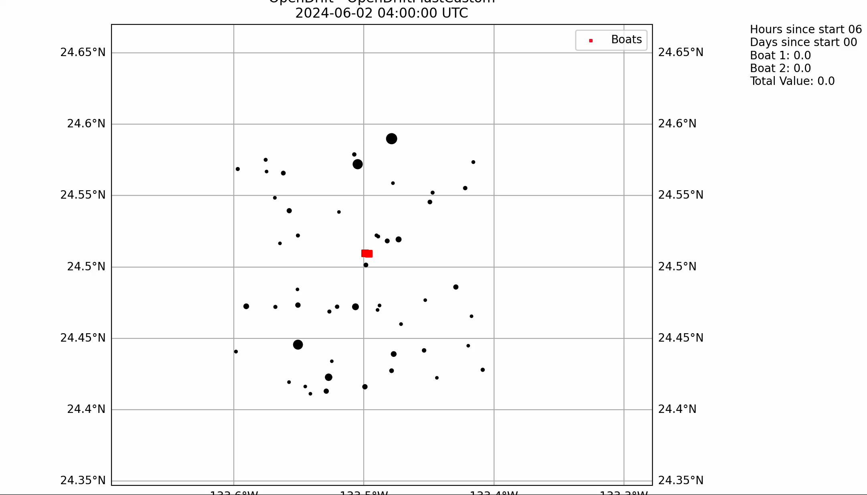
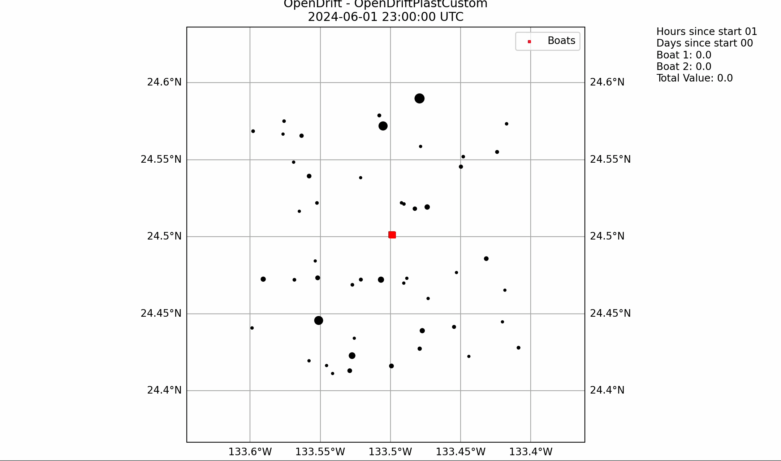
Example: Video of Boats focused on Value vs. Distance
Focus only on the Value of Patches Focus only on the Distance to Boats

Slide 11
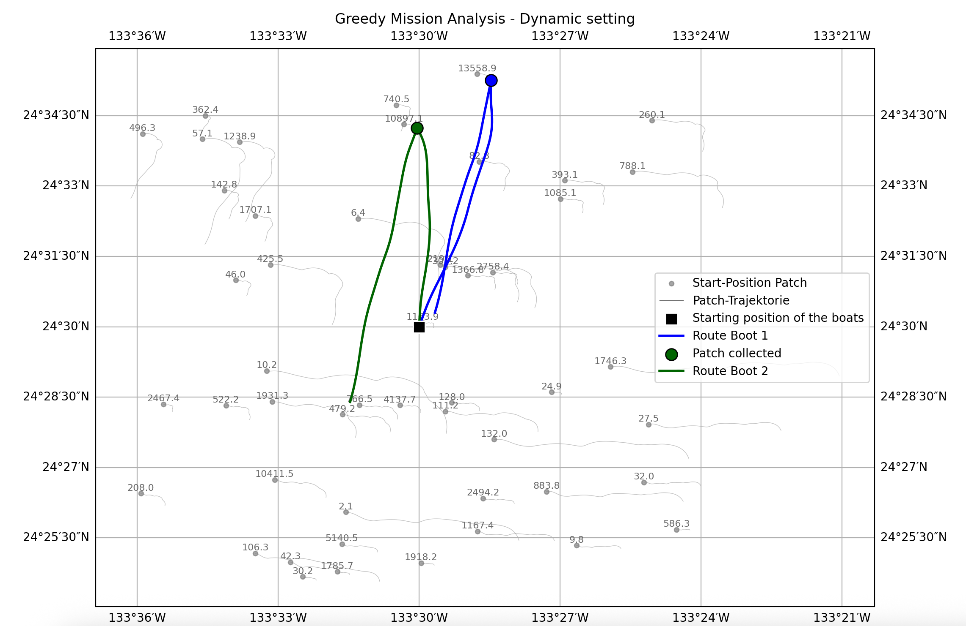
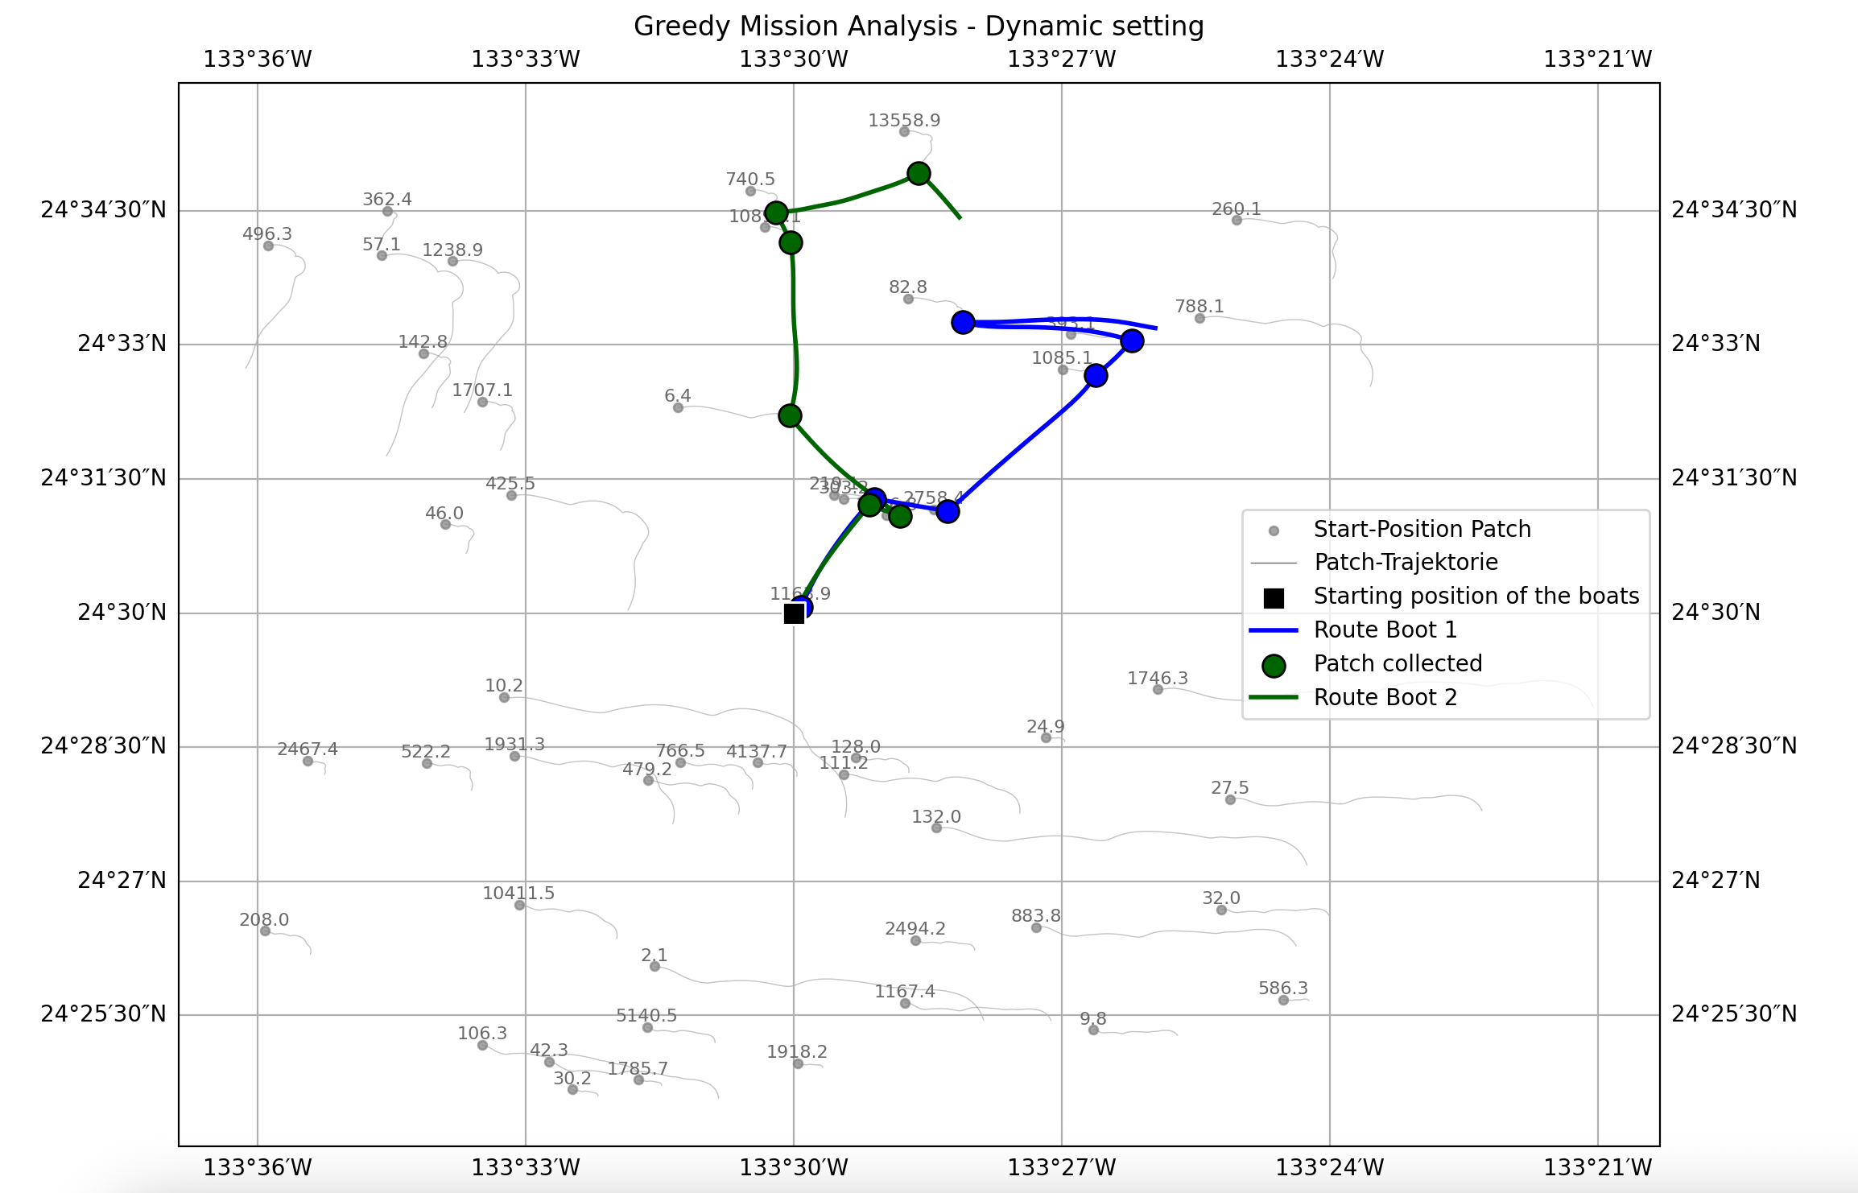
Example: Trajectory of Boats with Focus on Value vs. Distance
Focus only on Value of Patches Focus only on Distance to Boats
Total Value collected: 24 560 Total Value collected: 32 575
Notes:
Results hinzufügen

Slide 12
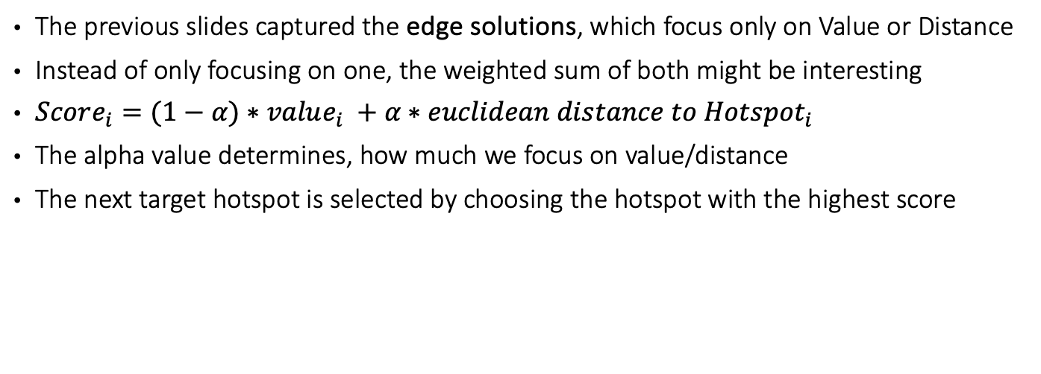
Weighted Sum as the Selection Criteria
The previous slides captured the edge solutions, which focus only on Value or Distance
Instead of only focusing on one, the weighted sum of both might be interesting
$Score_{i}=(1−α)∗value_{i} +α∗euclidean distance to {Hotspot}_{i}$
The alpha value determines, how much we focus on value/distance
The next target hotspot is selected by choosing the hotspot with the highest score

Slide 13
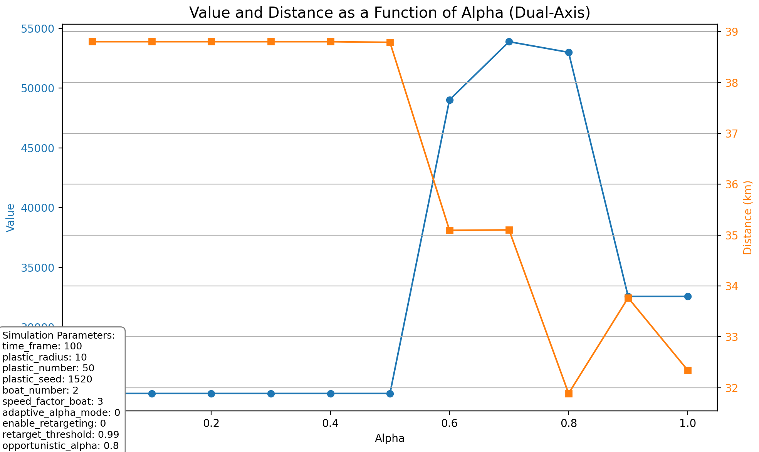
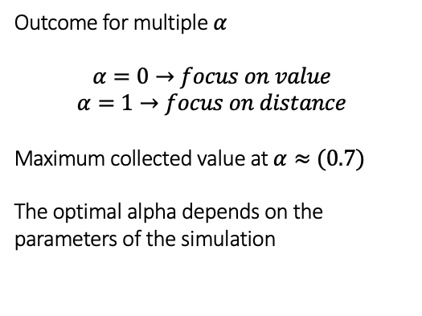

How does $α$influence the Solution?
Outcome for multiple $α$
$$α=0→focus on value$$
$$α=1→focus on distance$$
Maximum collected value at $α≈(0.7)$
The optimal alpha depends on the parameters of the simulation

Slide 14
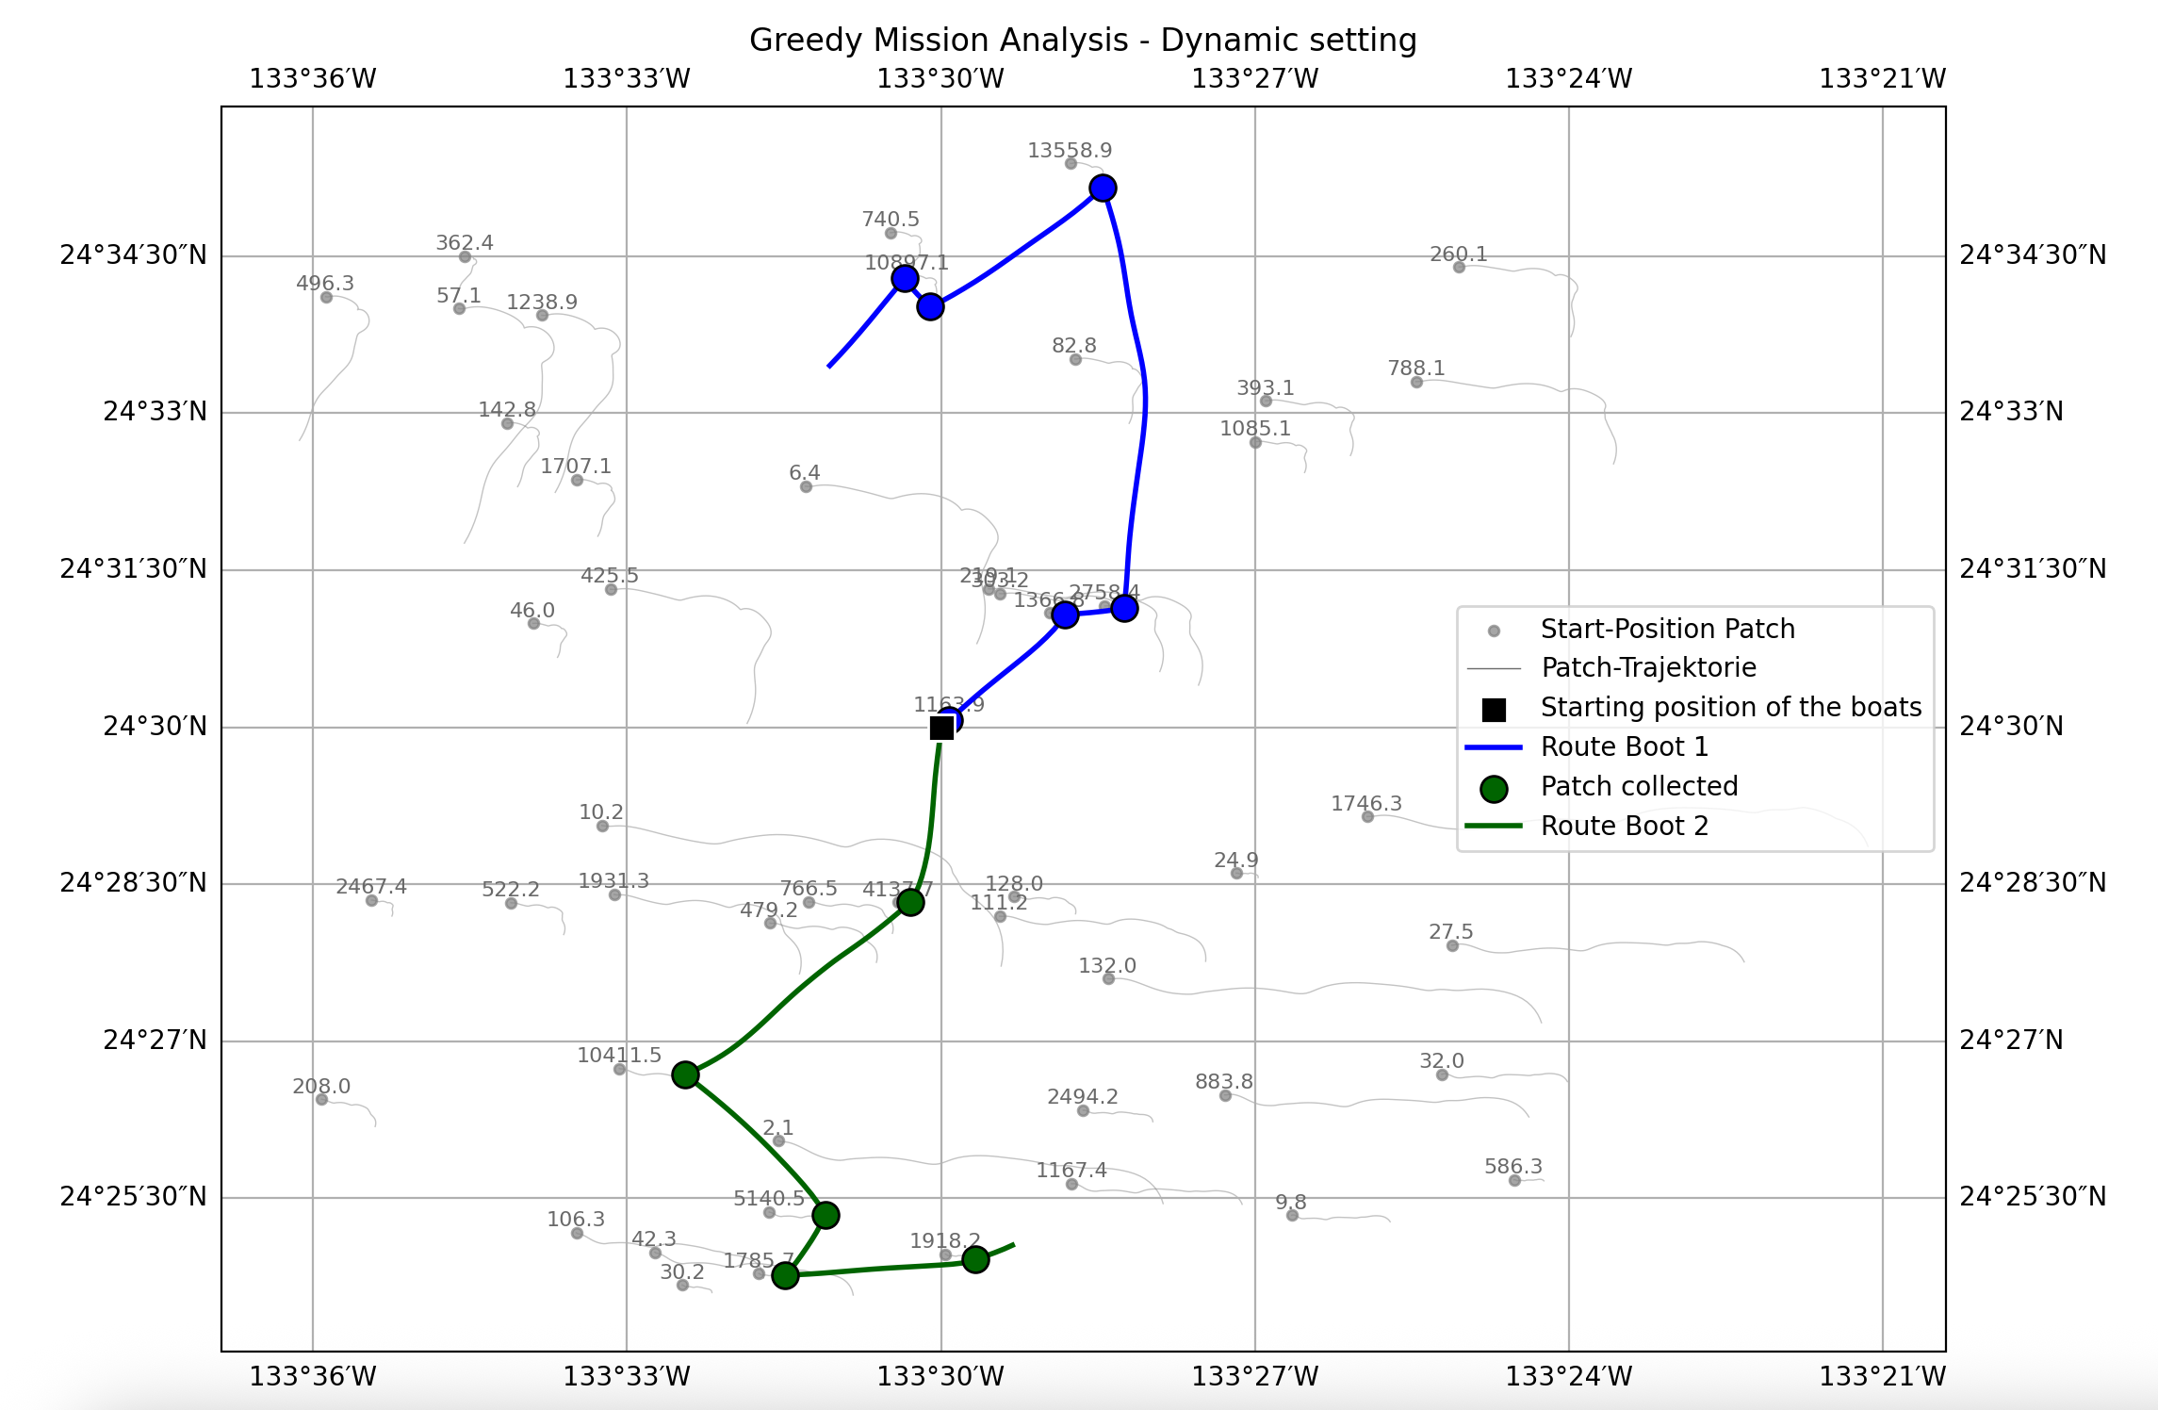

Example: Trajectory with optimal $α$ of 0.7
Total collected value: 53 879.16
Improvement to the previous edge solutions, which were at around: 24 000 (value) and 32 000 (distance)
Notes:
Result hinzufügen

Slide 15
Retargeting
Since the Greedy is short sighted, a "retargeting" mechanism is implemented, that allows a boat to switch the assigned patch.
Concept
The algorithm allows a boat that is already on the way to a target to dynamically switch to a new, more opportunistic hotspot. This allows to collect a patch that happens to be very close to the boat's current path, even if it wasn't the original destination.
Mechanism
Calculate Opportunistic Score: The boat calculates a new score for all nearby patches. This calculation uses an "opportunistic alpha" value, which strongly prioritizes distance over the patch's intrinsic value.
Compare Targets: The highest "opportunistic score" is then compared against the score of the boat's current, primary target.

Slide 16
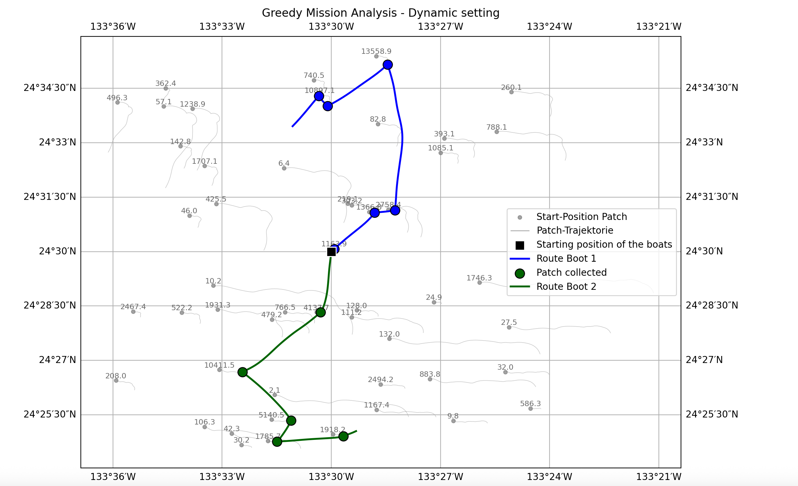
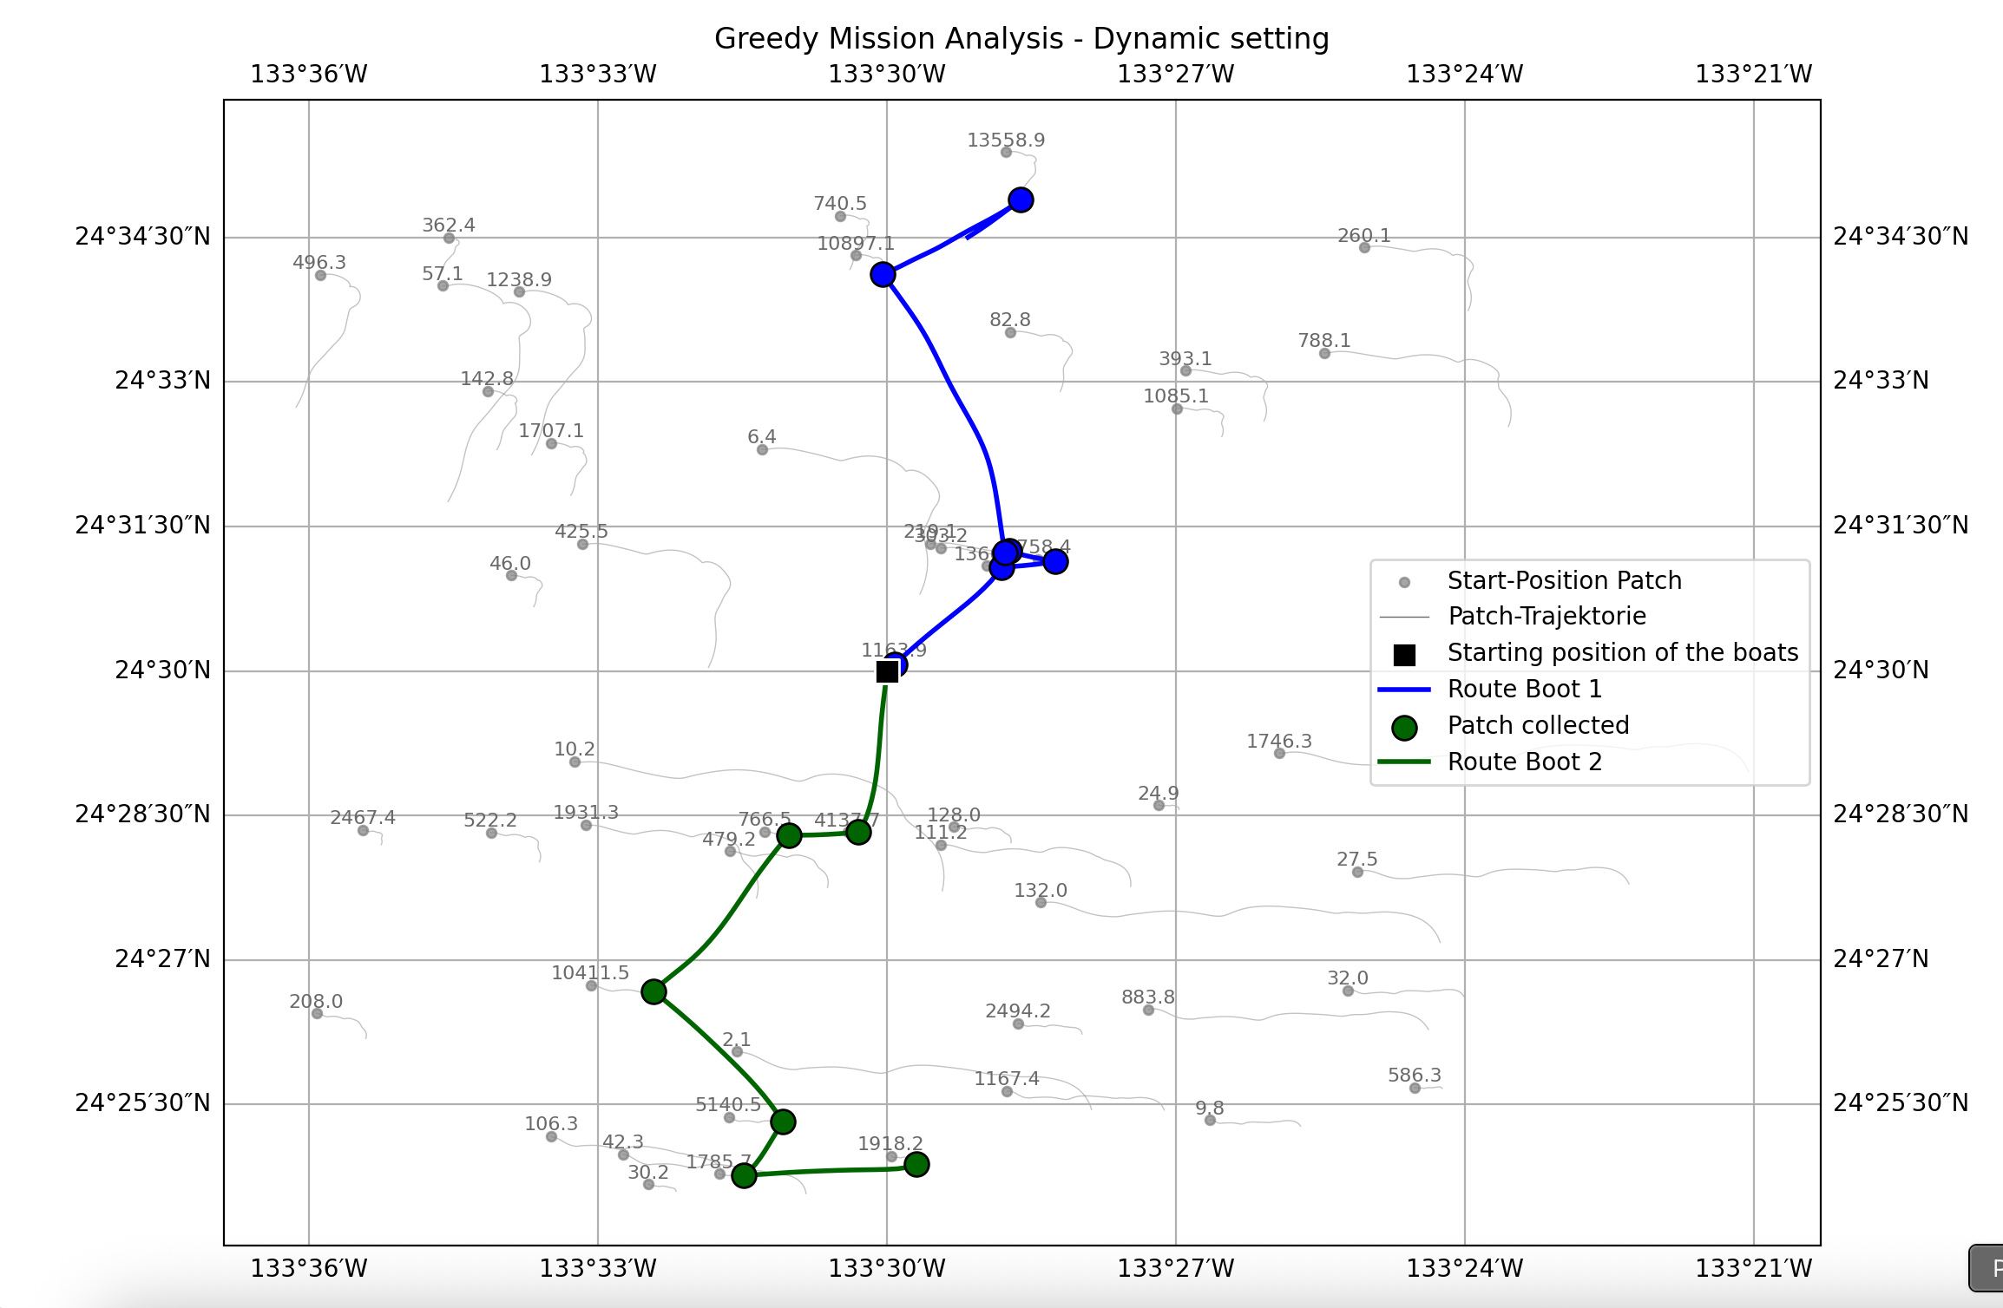
Retargeting – deactivated vs. activated
Retargeting turned off:
Result
Total Value: 53879.16
Total Distance: 35.1 km
Boats with Collection: 2 of 2
Alpha = 0.7
Retargeting turned om:
Results
Total Value: 54427.40
Total Distance: 32.03 km
Boats with Collection: 2 of 2
Alpha = 0.7

Slide 17
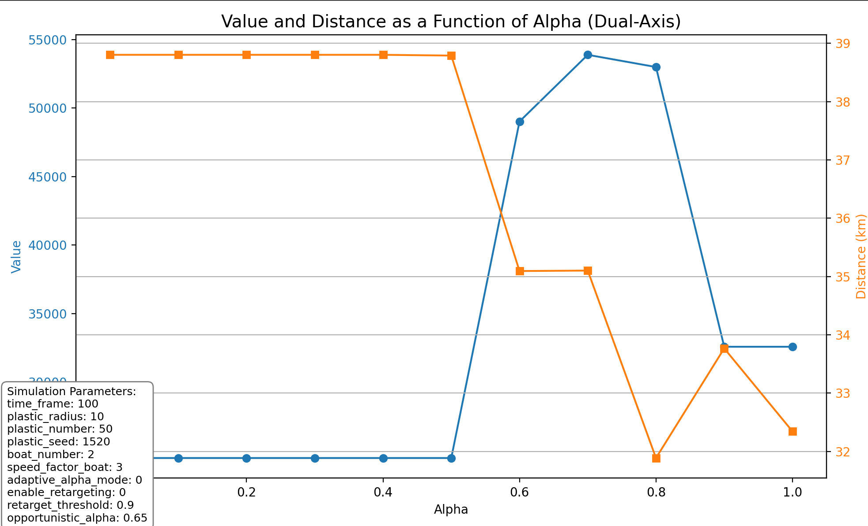
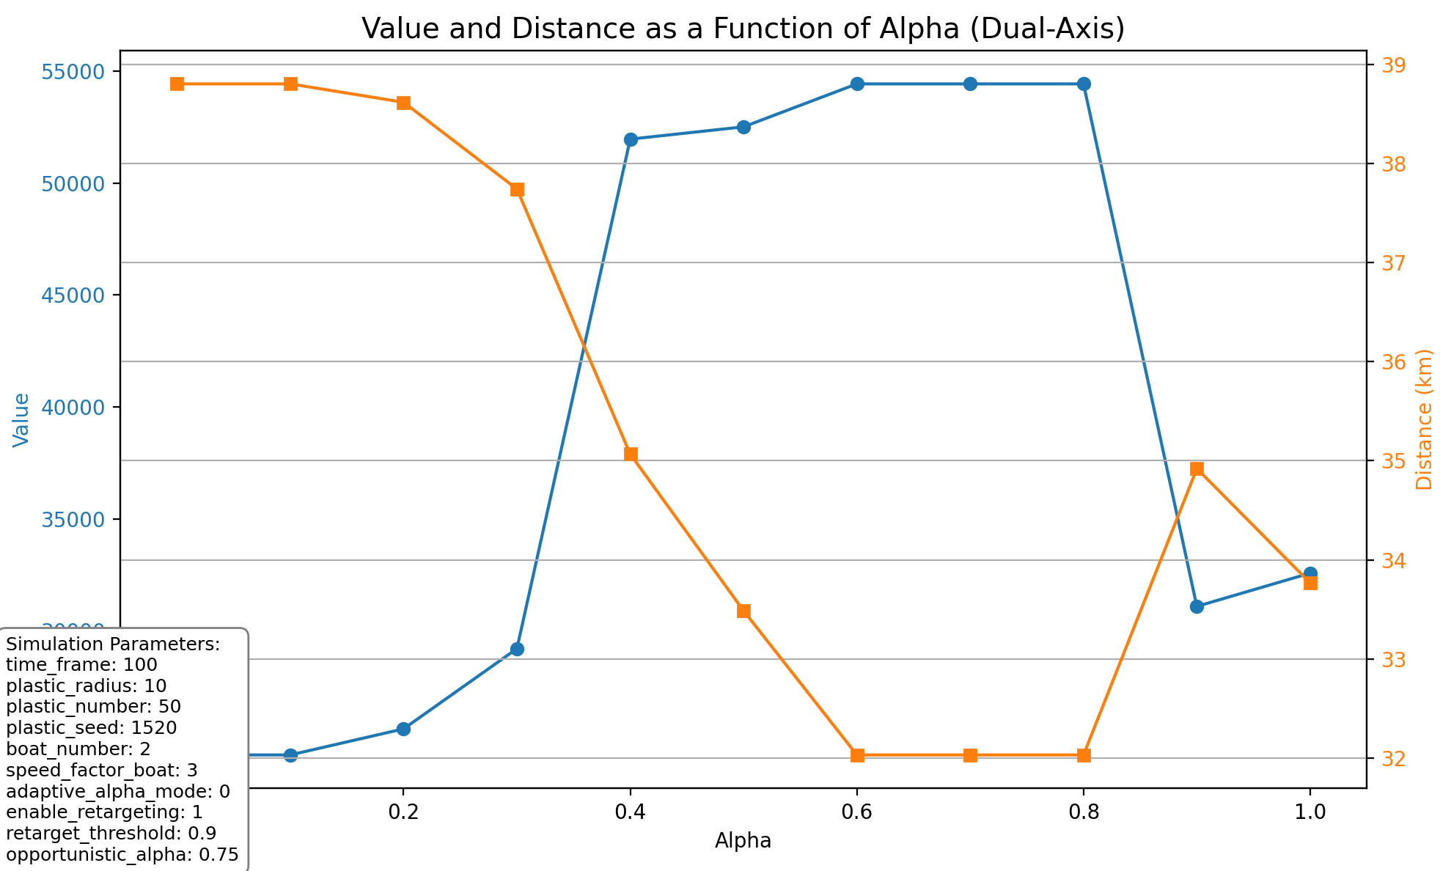
Comparison between Retargeting inactive/ active for different alpha values
Since we are able to target hotspots “on the way”, focusing the strategy on the value of the hotspot $(α$ towards zero) is more effective.

Slide 18
Static solution approach
First finding the theoretically optimal route by simplifying the problem, and then testing that route in a realistic environment.
Step 1: Simplify and Solve
Assumption: To make the problem solvable with standard optimizers, we temporarily ignore ocean currents. This means the plastic hotspots are stationary and the collection boats are not effected by the current. Use the Gurobi solver to find the optimal solution for this simplified, static model. (done)
Step 2: Validate in a Dynamic Environment
Result: The output from the solver is a pre-planned, optimal baseline route for the simplified problem.
Test: This static route is then simulated in our dynamic environment—with moving hotspots and currents—to see how well it actually performs under realistic conditions.
This is where I am working on right now

Slide 19
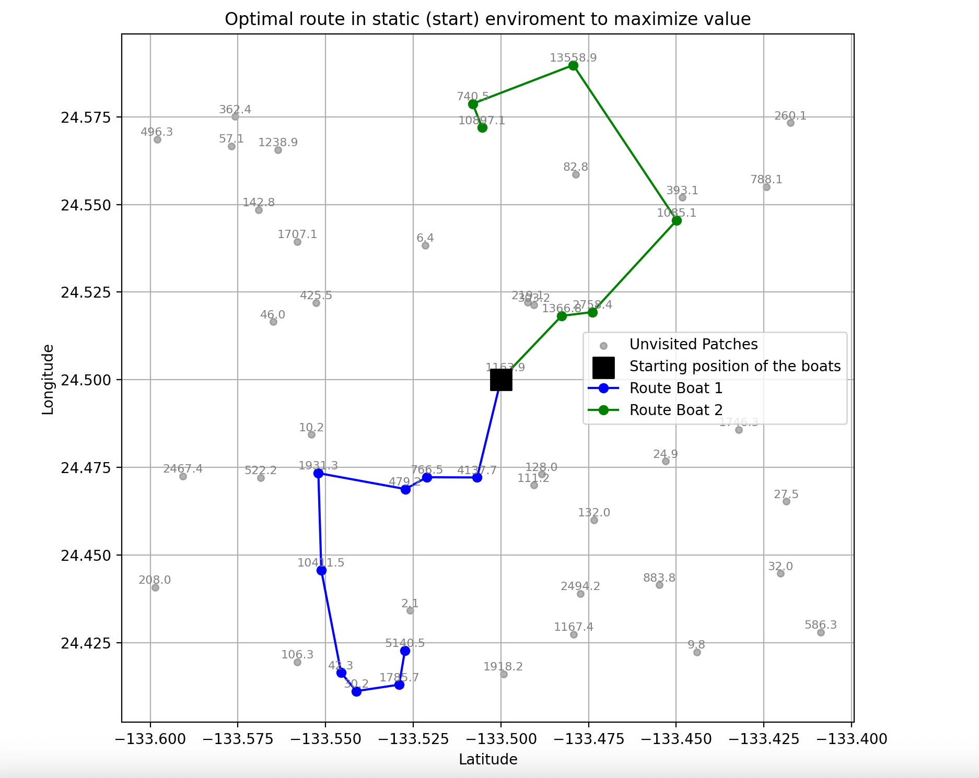
Optimal trajectory
This is an Optimal Route with a value of: 56 295.57
It is the same setting as in the other slides
We can see how all routes are different, depending on the solution method

Slide 20

Apply static Solution to dynamic Setting
Use the optimal static solution and apply it via simulation in the realistic environment
Currently under construction
Question will be if/how much the optimal value will decrease in the dynamic setting
I also planned to implement this exact optimization dynamically during the simulation at different timesteps, but I am not sure if that will be still part of the thesis or a possible extension.

Slide 21
Research Questions
How does the alpha parameter (value–distance weighting) affect overall collection performance?
How does Retargeting influence the outcome?
Which instance features (e.g. time window, patch density, area size, number of targets, number of boats) most impact solution quality and the optimal alpha?
How does the solution of the static approach perform under realistic settings

Slide 22
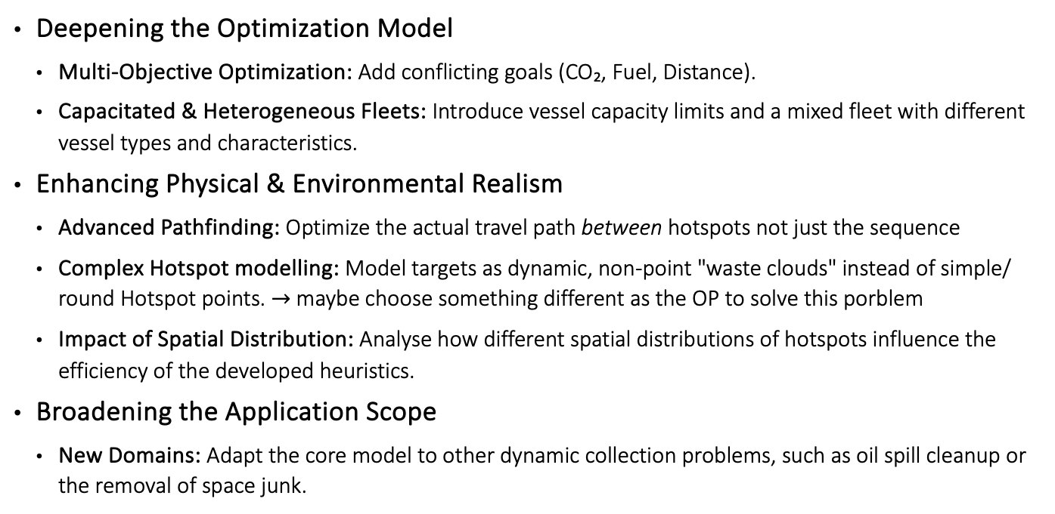
Potential extensions of the Problem
Deepening the Optimization Model
Multi-Objective Optimization: Add conflicting goals (CO₂, Fuel, Distance).
Capacitated & Heterogeneous Fleets: Introduce vessel capacity limits and a mixed fleet with different vessel types and characteristics.
Enhancing Physical & Environmental Realism
Advanced Pathfinding: Optimize the actual travel path between hotspots not just the sequence
Complex Hotspot modelling: Model targets as dynamic, non-point "waste clouds" instead of simple/ round Hotspot points. $→$ maybe choose something different as the OP to solve this porblem
Impact of Spatial Distribution: Analyse how different spatial distributions of hotspots influence the efficiency of the developed heuristics.
Broadening the Application Scope
New Domains: Adapt the core model to other dynamic collection problems, such as oil spill cleanup or the removal of space junk.

Slide 23
Sources (only the ones regarding information about the Setting/ Patch)
https://data.marine.copernicus.eu/products
https://opendrift.github.io
https://theoceancleanup.com/great-pacific-garbage-patch/
Densities of neuston often not elevated within plastic hotspots territory inside the North Pacific Garbage Patch - Matthias Egger et al 2024 Environ. Res.: Ecology 3 035002
Hotspots of Floating Plastic Particles across the North Pacific Ocean - Robby Rynek et al Environmental Science & Technology 2024 58 (9), 4302-4313, DOI: 10.1021/acs.est.3c05039
Lebreton, L., Slat, B., Ferrari, F. et al. Evidence that the Great Pacific Garbage Patch is rapidly accumulating plastic. Sci Rep 8, 4666 (2018). https://doi.org/10.1038/s41598-018-22939-w

